Slide 1
SQL – Subqueries
CS 4710
Database Systems

Slide 2
Course Update
Zybook Assignment 2 due on 03/08
Project phase 3 due on 03/06
Each group must submit a detailed and well thought-out development plan including the following:
The relational schema of your database. Remember to include all keys. Convert the ER diagram from phase 2 to relational model.
The final choice of databases and software platforms/languages that you will be using.
Where and how you will get data for your application. Do you get it from the web, some other application, or do you make it up.
Describe the labor division among group members.
A project timeline with milestones. Provide a 4-6 weeks plan for your project's implementation.

Slide 3

 | revisit
Aggregation: Order of Actions
SELECT select_list
FROM table_source
[WHERE search_condition] [GROUP BY group_by_expression] [HAVING search_condition]
[ORDER BY order_expression [ASC | DESC] ]
Order matters
The FROM clause generates the data set
The WHERE clause filters the data set generated by the FROM clause
The GROUP BY clause aggregates the data set that was filtered by the WHERE clause (note: GROUP BY does not sort the result set)
The HAVING clause filters the data set that was aggregated by the GROUP BY clause
The SELECT clause transforms the filtered aggregated data set
The ORDER BY clause sorts the transformed data set

Slide 4
Join combines data across tables
 | revisit
Joins
Nested-loop
Natural join (most common)
Inner join (filter Cartesian product)
Outer joins (preserve non-matching tuples)
Self join pattern
Different joining techniques can be used to achieve particular goals
NATURAL JOIN
(INNER) JOIN
LEFT JOIN
RIGHT JOIN
left table
right table
left table
right table
left table
right table
left table
right table

Slide 5
Recap 1: JOIN
Find the total number of unique sailors who have reserved each boat (ordered the number of sailors in descending order).
Display the count, boat name, and boat id
Boats (bid, bname, color)
Sailors (sid, Reserves (sid,
sname, rating, age) bid, day)
SELECT b.bid, b.bname, COUNT(DISTINCT r.sid) AS sailor_count
FROM Boats b
LEFT JOIN Reserves r ON b.bid = r.bid
GROUP BY b.bid, b.bname;
5

Slide 6
Recap 2: JOIN
Find the average age of sailors who have reserved each boat. Show boat name, boat id, and the average age.
Order results by boat id.
Boats (bid, bname, color)
Sailors (sid, Reserves (sid,
sname, rating, age) bid, day)
SELECT b.bid, b.bname, AVG(s.age) AS average_age
FROM Boats b
LEFT JOIN Reserves r ON b.bid = r.bid
LEFT JOIN Sailors s ON r.sid = s.sid
GROUP BY b.bid, b.bname
ORDER BY b.bid;
6

Slide 7
Recap 3: JOIN
Find the average age of sailors who have reserved each boat? Show boat name, bid, and the average age. Order results by bid. (from Recap 2)
In addition, only show the boat info where the average age of sailors who have reserved that boat is > 35 years old.
Boats (bid, bname, color)
Sailors (sid, Reserves (sid,
sname, rating, age) bid, day)
SELECT b.bid, b.bname, AVG(s.age) AS average_age
FROM Boats b
LEFT JOIN Reserves r ON b.bid = r.bid
LEFT JOIN Sailors s ON r.sid = s.sid
GROUP BY b.bid, b.bname
HAVING AVG(s.age) > 35
ORDER BY b.bid;
7

Slide 8
Recap 4: Self Join
Find all students (sid) who live in the same city and on the same street as their mentor
Mentorship (mentee_sid, mentor_sid)
-- mentor_sid is a mentor of another student mentee_sid
Study (sid, credits) Enrollment (dept_id, Student (sid, street,
-- credits the student has taken
sid) -- dept the student is enrolled in
city) -- street, city the student lives
SELECT DISTINCT m.mentor_sid AS mentor, s1.sid AS student
FROM Mentorship m
JOIN Student s1 ON m.mentee_sid = s1.sid
JOIN Student s2 ON m.mentor_sid = s2.sid
WHERE s1.street = s2.street
AND s1.city = s2.city;

Slide 9



Subqueries: Core Idea
Split your problem into sub-problems
Solve them separately
Compose them
The smaller the problem, the simpler to solve, the easier to debug

Slide 10
Subqueries
Subquery = a query that is part of another query
A subquery can have subqueries
Usage:
Return a single constant that can be used to compute an associated value in a SELECT clause
Return a single constant that can be compared to another value in a WHERE clause
Return a relation that can be compared or evaluated in a WHERE
clause
Return a relation that can be used as input for another query, in a FORM clause

Slide 11
Equivalent Query Example
Find the average salary for each job
practice_emp
job | AvgSal
Analyst | 3500.0000
Clerk | 1437.5000
Manager | 3158.3333
President | 6500.0000
Salesman | 1800.0000
empno | ename | job | sal
7369 | Smith | Clerk | 1200
7499 | Allen | Salesman | 2000
7521 | Ward | Salesman | 1650
7566 | Jones | Manager | 3375
7654 | Martin | Salesman | 1650
7698 | Blake | Manager | 3250
7782 | Clark | Manager | 2850
7788 | Scott | Analyst | 3500
7839 | King | President | 6500
7844 | Turner | Salesman | 1900
7876 | Adams | Clerk | 1500
7900 | James | Clerk | 1350
7902 | Ford | Analyst | 3500
7934 | Miller | Clerk | 1700
SELECT job, AVG(sal) FROM practice_emp GROUP BY job
Idea (self join):
Self-join practice_emp
Use one copy to aggregate, group by job
Use one copy to keep the original job
SELECT E1.job, AVG(E2.sal) AS AvgSal FROM practice_emp E1, practice_emp E2 WHERE E1.job = E2.job
GROUP BY E1.job

Slide 12

(Equivalent) Subquery (SELECT)
Find the average salary for each job
practice_emp
“Correlated” query Recomputed for each tuple (can’t be run independently of the outer query)
empno | ename | job | sal
7369 | Smith | Clerk | 1200
7499 | Allen | Salesman | 2000
7521 | Ward | Salesman | 1650
7566 | Jones | Manager | 3375
7654 | Martin | Salesman | 1650
7698 | Blake | Manager | 3250
7782 | Clark | Manager | 2850
7788 | Scott | Analyst | 3500
7839 | King | President | 6500
7844 | Turner | Salesman | 1900
7876 | Adams | Clerk | 1500
7900 | James | Clerk | 1350
7902 | Ford | Analyst | 3500
7934 | Miller | Clerk | 1700
SELECT E1.job,
(SELECT AVG(E2.sal)
FROM practice_emp AS E2
WHERE E1.job = E2.job) AS AvgSal
FROM practice_emp E1 GROUP BY E1.job
job
AvgSal
Analyst
3500.0000
Clerk
1437.5000
Manager
3158.3333
President
6500.0000
Idea:
Salesman 1800.0000
Group by job
For each tuple, compute aggregate
A subquery in SELECT returns a single value – used to compute an associated value

Slide 13
(Equivalent) Subquery (FROM)
Find the average salary for each job
“Uncorrelated” query Independent of outer query
practice_emp
SELECT E1.job, AvgSal FROM practice_emp E1,
empno | ename | job | sal
7369 | Smith | Clerk | 1200
7499 | Allen | Salesman | 2000
7521 | Ward | Salesman | 1650
7566 | Jones | Manager | 3375
7654 | Martin | Salesman | 1650
7698 | Blake | Manager | 3250
7782 | Clark | Manager | 2850
7788 | Scott | Analyst | 3500
7839 | King | President | 6500
7844 | Turner | Salesman | 1900
7876 | Adams | Clerk | 1500
7900 | James | Clerk | 1350
7902 | Ford | Analyst | 3500
7934 | Miller | Clerk | 1700
(SELECT job, AVG(sal) AS AvgSal FROM practice_emp
GROUP BY job) AS E2
WHERE E1.job = E2.job
GROUP BY E1.job
job
AvgSal
Analyst
3500.0000
Clerk
1437.5000
Manager
3158.3333
President
6500.0000
Idea:
Salesman
1800.0000
Compute aggregate for each job
Join the original practice_emp
A subquery in FROM returns a relation – used as input for another query

Slide 14
Subqueries in WHERE
Find employee name (or names) who earns the highest salary for each job
practice_emp
SELECT E1.ename
FROM practice_emp E1 WHERE E1.sal =
empno | ename | job | sal
7369 | Smith | Clerk | 1200
7499 | Allen | Salesman | 2000
7521 | Ward | Salesman | 1650
7566 | Jones | Manager | 3375
7654 | Martin | Salesman | 1650
7698 | Blake | Manager | 3250
7782 | Clark | Manager | 2850
7788 | Scott | Analyst | 3500
7839 | King | President | 6500
7844 | Turner | Salesman | 1900
7876 | Adams | Clerk | 1500
7900 | James | Clerk | 1350
7902 | Ford | Analyst | 3500
7934 | Miller | Clerk | 1700
(SELECT MAX(E2.sal)
FROM practice_emp AS E2 WHERE E1.job = E2.job)
ename
Allen
Jones
“Correlated”
Scott
King
Ford
Miller
[more subqueries in WHERE later]
A subquery in WHERE returns a single value – to be compared to another value in a WHERE clause

Slide 15

Subqueries in WITH
Find employee name (or names) who earns the highest salary for each job
“Uncorrelated”
practice_emp
WITH temp AS
empno | ename | job | sal
7369 | Smith | Clerk | 1200
7499 | Allen | Salesman | 2000
7521 | Ward | Salesman | 1650
7566 | Jones | Manager | 3375
7654 | Martin | Salesman | 1650
7698 | Blake | Manager | 3250
7782 | Clark | Manager | 2850
7788 | Scott | Analyst | 3500
7839 | King | President | 6500
7844 | Turner | Salesman | 1900
7876 | Adams | Clerk | 1500
7900 | James | Clerk | 1350
7902 | Ford | Analyst | 3500
7934 | Miller | Clerk | 1700
(SELECT job, MAX(sal) AS maxSal FROM practice_emp
GROUP BY job)
SELECT FROM WHERE
E1.ename
practice_emp AS E1, temp AS T
E1.sal = T.maxSal AND E1.job = T.job
ename
Allen
Jones
Scott
King
Ford
Miller
A subquery in WITH clause returns a temporary relation that can be used by an associated query
[WITH -- not supported by MySQL 5.6, 5.7; work on MySQL 8.0 (GCP and CS server) and XAMPP MariaDB]

Slide 16
Let’s Try 1: Self Join
For each person, find the average salary of their job (assume we will display empno, ename, and average salary of the person’s job)
practice_emp
empno | ename | job | sal
7369 | Smith | Clerk | 1200
7499 | Allen | Salesman | 2000
7521 | Ward | Salesman | 1650
7566 | Jones | Manager | 3375
7654 | Martin | Salesman | 1650
7698 | Blake | Manager | 3250
7782 | Clark | Manager | 2850
7788 | Scott | Analyst | 3500
7839 | King | President | 6500
7844 | Turner | Salesman | 1900
7876 | Adams | Clerk | 1500
7900 | James | Clerk | 1350
7902 | Ford | Analyst | 3500
7934 | Miller | Clerk | 1700
SELECT e1.emp_no, e1.emp_name, AVG(e2.sal) AS avg_job_salary
FROM practice_emp e1
JOIN practice_emp e2 ON e1.job = e2.job
GROUP BY e1.emp_no, e1.emp_name;

Slide 17
Let’s Try 1: Subqueries in SELECT
For each person, find the average salary of their job (assume we will display empno, ename, and average salary of the person’s job)
practice_emp
Step 1: Find each person’s empno and ename
empno | ename | job | sal
7369 | Smith | Clerk | 1200
7499 | Allen | Salesman | 2000
7521 | Ward | Salesman | 1650
7566 | Jones | Manager | 3375
7654 | Martin | Salesman | 1650
7698 | Blake | Manager | 3250
7782 | Clark | Manager | 2850
7788 | Scott | Analyst | 3500
7839 | King | President | 6500
7844 | Turner | Salesman | 1900
7876 | Adams | Clerk | 1500
7900 | James | Clerk | 1350
7902 | Ford | Analyst | 3500
7934 | Miller | Clerk | 1700
SELECT emp_no, emp_name
FROM practice_emp;
Step 2: Given the job of the person, find the average salary of that job
SELECT emp_no, emp_name, job,
(SELECT AVG(sal)
FROM practice_emp
WHERE job = p.job) AS avg_job_salary
FROM practice_emp p;

Slide 18
Let’s Try 1: Subqueries in FROM
For each person, find the average salary of their job (assume we will display empno, ename, and average salary of the person’s job)
practice_emp
Step 1: Find average salary of each job
empno | ename | job | sal
7369 | Smith | Clerk | 1200
7499 | Allen | Salesman | 2000
7521 | Ward | Salesman | 1650
7566 | Jones | Manager | 3375
7654 | Martin | Salesman | 1650
7698 | Blake | Manager | 3250
7782 | Clark | Manager | 2850
7788 | Scott | Analyst | 3500
7839 | King | President | 6500
7844 | Turner | Salesman | 1900
7876 | Adams | Clerk | 1500
7900 | James | Clerk | 1350
7902 | Ford | Analyst | 3500
7934 | Miller | Clerk | 1700
SELECT job, AVG(sal) AS avg_job_salary
FROM practice_emp
GROUP BY job;
Step 2: For each person, find the average salary of that the person’s job
SELECT p.emp_no, p.emp_name, p.job, j.avg_job_salary
FROM practice_emp p
JOIN (
SELECT job, AVG(sal) AS avg_job_salary
FROM practice_emp
GROUP BY job
) j ON p.job = j.job;

Slide 19
Let’s Try 1: Subqueries in WITH
For each person, find the average salary of their job (assume we will display empno, name, and average salary of the person’s job)
practice_emp
Step 1: Find average salary of each job
empno | ename | job | sal
7369 | Smith | Clerk | 1200
7499 | Allen | Salesman | 2000
7521 | Ward | Salesman | 1650
7566 | Jones | Manager | 3375
7654 | Martin | Salesman | 1650
7698 | Blake | Manager | 3250
7782 | Clark | Manager | 2850
7788 | Scott | Analyst | 3500
7839 | King | President | 6500
7844 | Turner | Salesman | 1900
7876 | Adams | Clerk | 1500
7900 | James | Clerk | 1350
7902 | Ford | Analyst | 3500
7934 | Miller | Clerk | 1700
WITH AvgJobSalaries AS (
SELECT job, AVG(sal) AS avg_job_salary
FROM practice_emp
GROUP BY job
)
SELECT emp_no, emp_name, job, avg_job_salary
FROM practice_emp
JOIN AvgJobSalaries ON practice_emp.job = AvgJobSalaries.job;

Slide 20
Let’s Try 1: Subqueries in WITH
For each person, find the average salary of their job (assume we will display empno, name, and average salary of the person’s job)
practice_emp
empno | ename | job | sal
7369 | Smith | Clerk | 1200
7499 | Allen | Salesman | 2000
7521 | Ward | Salesman | 1650
7566 | Jones | Manager | 3375
7654 | Martin | Salesman | 1650
7698 | Blake | Manager | 3250
7782 | Clark | Manager | 2850
7788 | Scott | Analyst | 3500
7839 | King | President | 6500
7844 | Turner | Salesman | 1900
7876 | Adams | Clerk | 1500
7900 | James | Clerk | 1350
7902 | Ford | Analyst | 3500
7934 | Miller | Clerk | 1700
Step 2: For each person, find the average salary of that the person’s job
SELECT emp_no, emp_name, job, avg_job_salary
FROM practice_emp
JOIN AvgJobSalaries ON practice_emp.job = AvgJobSalaries.job;

Slide 21
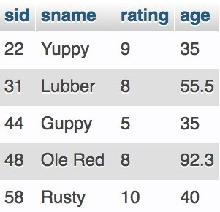
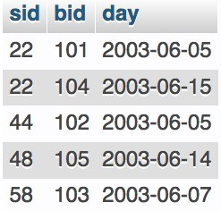
Let’s Try 2: Join (2)
For each sailor, find the number of boats they have reserved
(assume we will display sname and the number of boats)
Sailors Reserves
SELECT s.sname, COUNT(r.bid) AS num_of_boats_reserved
FROM Sailors s
LEFT JOIN Reserves r ON s.sid = r.sid
GROUP BY s.sname;

Slide 22
Let’s Try: Subqueries in SELECT
For each sailor, find the number of boats they have reserved
(assume we will display sname and the number of boats)
Sailors Reserves
SELECT s.sname,
(SELECT COUNT(*) FROM Reserves r WHERE r.sid = s.sid) AS num_of_boats_reserved
FROM Sailors s;

Slide 23
Subqueries and Set Operations
UNION
(sub-result1)
UNION
(sub-result2)
Requirements:
Same number of columns
Same order of columns
Same column data types
INTERSECT
[not supported by MySQL 5.6, 5.7; work on MySQL
8.0 (GCP and CS server) and local XAMPP 10.4.11-
MariaDB]
(sub-result1)
INTERSECT
(sub-result2)
EXCEPT
(sub-result1)
EXCEPT
(sub-result2)
[not supported by MySQL 5.6, 5.7; work on MySQL
8.0 (GCP and CS server) and local XAMPP 10.4.11-
MariaDB]
We talked about UNION and INTERSECT. Let’s consider EXCEPT

Slide 24
Example: Let’s Solve A Problem
Use the following schema. Find IDs and names of all customers who have purchased products sold by company 7777 only. Do not list customers who have purchased from any other companies.
Product(pid,
-- cid is
Company(cid,
name, cid)
foreign key to Company.cid
cname, city)
Customer(custId, name, city)
Purchase(purchase_date, pid, custId, quantity, price)
-- pid is foreign key to Product.pid,
-- custId is foreign key to Customer.custId
Assume each customer may purchase the same product multiple times
How should we solve this problem?

Slide 25

Example: Let’s Solve A Problem
(sub-result1)
^{EXCEPT} Set difference (–)
(sub-result2)
How should we solve this problem?
(Find all customers who have purchased)
EXCEPT
1
2 (Find all customers who have purchased from other companies, not 7777)

Slide 26
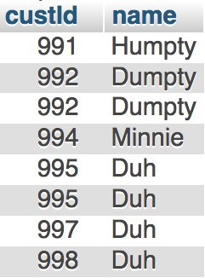
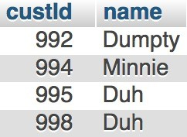
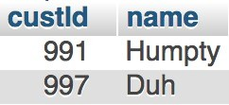
Use EXCEPT to Solve the Problem
(Find all customers who have purchased)
EXCEPT
1
2
(Find all customers who have purchased from other companies, not 7777)
(sub-result1) (sub-result2)
(difference)
– =

Slide 27
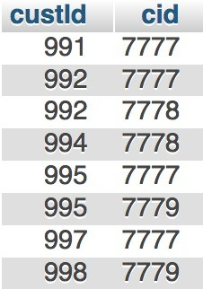
Use EXCEPT to Solve the Problem (2)
1 (Find all customers who have purchased)
Find which companies the customers have purchased.
Then, find the names of the customers
SELECT T1.custId, T2.cid FROM Purchase T1 NATURAL JOIN Product T2
GROUP BY T1.custId, T2.cid
Got all customers who have purchased. Still need to find the names of the customers

Slide 28
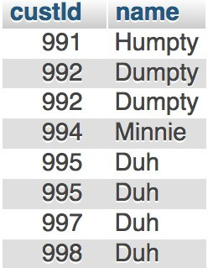
Use EXCEPT to Solve the Problem (3)
1 (Find all customers who have purchased)
Find which companies the customers have purchased Then, find the names of the customers
SELECT T3.custId, T3.name
FROM (SELECT T1.custId, T2.cid
FROM Purchase T1 NATURAL JOIN Product T2 GROUP BY T1.custId, T2.cid) T
NATURAL JOIN Customer T3

Slide 29
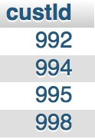
Use EXCEPT to Solve the Problem (4)
2 (Find all customers who have purchased from other companies, not 7777)
Find all customers who have purchased from other companies Then, find the names of the customers
SELECT
T1.custId
FROM Purchase
T1 NATURAL JOIN Product T2
WHERE T2.cid <> 7777 GROUP BY
T1.custId
Got all customers who have not purchased from 7777.
Still need to find the names of the customers

Slide 30
Use EXCEPT to Solve the Problem (5)
2 (Find all customers who have purchased from other companies, not 7777)
Find all customers who have purchased from other companies Then, find the names of the customers
SELECT
T3.custId,
T3.name
FROM (SELECT T1.custId
FROM Purchase T1 NATURAL JOIN Product T2 WHERE T2.cid <> 7777
GROUP BY T1.custId) T
NATURAL JOIN Customer T3

Slide 31
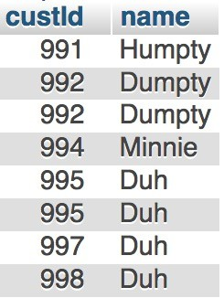
Use EXCEPT to Solve the Problem (6)
(SELECT T3.custId, T3.name
FROM (SELECT T1.custId, T2.cid
1
FROM Purchase T1 NATURAL JOIN Product T2 GROUP BY T1.custId, T2.cid) T
NATURAL JOIN Customer T3)
EXCEPT
–
(SELECT T3.custId, T3.name FROM (SELECT T1.custId
2
FROM Purchase T1 NATURAL JOIN Product T2 WHERE T2.cid <> 7777
GROUP BY T1.custId) T
NATURAL JOIN Customer T3)
=

Slide 32
Example: UNION
(SELECT T3.custId, T3.name
FROM (SELECT T1.custId, T2.cid
FROM Purchase T1 NATURAL JOIN Product T2 GROUP BY T1.custId, T2.cid) T
NATURAL JOIN Customer T3)
UNION
U
(SELECT T3.custId, T3.name FROM (SELECT T1.custId
FROM Purchase T1 NATURAL JOIN Product T2 WHERE T2.cid <> 7777
GROUP BY T1.custId) T
NATURAL JOIN Customer T3)
=

Slide 33
Example: INTERSECT
(SELECT T3.custId, T3.name
FROM (SELECT T1.custId, T2.cid
FROM Purchase T1 NATURAL JOIN Product T2 GROUP BY T1.custId, T2.cid) T
NATURAL JOIN Customer T3)
∩
INTERSECT
(SELECT T3.custId, T3.name FROM (SELECT T1.custId
FROM Purchase T1 NATURAL JOIN Product T2 WHERE T2.cid <> 7777
GROUP BY T1.custId) T
NATURAL JOIN Customer T3)
=

Slide 34
Wrap-Up
Subqueries in SELECT, FROM
Abstract immediate result using WITH
Equivalent queries
Intro to subqueries in WHERE
Subqueries and set operations
Note:
Avoid nested queries – if aiming for speed
Be careful of semantics of nested queries
Correlated vs. Uncorrelated
What’s next?
Subqueries in WHERE
Existential and universal quantifiers
Triggers and constraints

Slide 35
Zybook task
Let’s do 3.11-3.14

Slide 36
More Practice / Example

Slide 37
Find employee name (or names) who earns the highest salary for each job
 | revisit, slide 14
Previous Solution
practice_emp
SELECT E1.ename
FROM practice_emp E1 WHERE E1.sal =
empno | ename | job | sal
7369 | Smith | Clerk | 1200
7499 | Allen | Salesman | 2000
7521 | Ward | Salesman | 1650
7566 | Jones | Manager | 3375
7654 | Martin | Salesman | 1650
7698 | Blake | Manager | 3250
7782 | Clark | Manager | 2850
7788 | Scott | Analyst | 3500
7839 | King | President | 6500
7844 | Turner | Salesman | 1900
7876 | Adams | Clerk | 1500
7900 | James | Clerk | 1350
7902 | Ford | Analyst | 3500
7934 | Miller | Clerk | 1700
(SELECT MAX(E2.sal)
FROM practice_emp AS E2 WHERE E1.job = E2.job)
ename
Allen
Jones
“Correlated”
Scott
King
Ford
Miller
[more subqueries in WHERE later]
A subquery in WHERE returns a single value – to be compared to another value in a WHERE clause

Slide 38
Alternative Ways to Solve
Find the employee name (or employees) with the highest salary for each job title
practice_emp
empno | ename | job | sal
7369 | Smith | Clerk | 1200
7499 | Allen | Salesman | 2000
7521 | Ward | Salesman | 1650
7566 | Jones | Manager | 3375
7654 | Martin | Salesman | 1650
7698 | Blake | Manager | 3250
7782 | Clark | Manager | 2850
7788 | Scott | Analyst | 3500
7839 | King | President | 6500
7844 | Turner | Salesman | 1900
7876 | Adams | Clerk | 1500
7900 | James | Clerk | 1350
7902 | Ford | Analyst | 3500
7934 | Miller | Clerk | 1700
How should we write SQL?

Slide 39
Option 1: Self-Join
Find the employee name (or employees) with the highest salary for each job title
practice_emp
empno | ename | job | sal
7369 | Smith | Clerk | 1200
7499 | Allen | Salesman | 2000
7521 | Ward | Salesman | 1650
7566 | Jones | Manager | 3375
7654 | Martin | Salesman | 1650
7698 | Blake | Manager | 3250
7782 | Clark | Manager | 2850
7788 | Scott | Analyst | 3500
7839 | King | President | 6500
7844 | Turner | Salesman | 1900
7876 | Adams | Clerk | 1500
7900 | James | Clerk | 1350
7902 | Ford | Analyst | 3500
7934 | Miller | Clerk | 1700
SELECT E1.ename, E2.job, MAX(E2.sal) FROM
practice_emp AS E1, practice_emp AS E2
WHERE GROUP BY
E1.job = E2.job
E1.sal, E1.ename
E2.job,
HAVING E1.sal = MAX(E2.sal);
ename | job | sal
Ford | Analyst | 3500
Scott | Analyst | 3500
Miller | Clerk | 1700
Jones | Manager | 3375
King | President | 6500
Allen | Salesman | 2000

Slide 40
Option 2: Subqueries
Find the employee name (or employees) with the highest salary for each job title
practice_emp
empno | ename | job | sal
7369 | Smith | Clerk | 1200
7499 | Allen | Salesman | 2000
7521 | Ward | Salesman | 1650
7566 | Jones | Manager | 3375
7654 | Martin | Salesman | 1650
7698 | Blake | Manager | 3250
7782 | Clark | Manager | 2850
7788 | Scott | Analyst | 3500
7839 | King | President | 6500
7844 | Turner | Salesman | 1900
7876 | Adams | Clerk | 1500
7900 | James | Clerk | 1350
7902 | Ford | Analyst | 3500
7934 | Miller | Clerk | 1700
Find max salary for each job
Then find the employee(s) with that max salary

Slide 41
Option 2: Subqueries
practice_emp
empno | ename | job | sal
7369 | Smith | Clerk | 1200
7499 | Allen | Salesman | 2000
7521 | Ward | Salesman | 1650
7566 | Jones | Manager | 3375
7654 | Martin | Salesman | 1650
7698 | Blake | Manager | 3250
7782 | Clark | Manager | 2850
7788 | Scott | Analyst | 3500
7839 | King | President | 6500
7844 | Turner | Salesman | 1900
7876 | Adams | Clerk | 1500
7900 | James | Clerk | 1350
7902 | Ford | Analyst | 3500
7934 | Miller | Clerk | 1700
Find max salary for each job SELECT E1.job, MAX(E1.sal) AS maxSal FROM practice_emp E1
GROUP BY E1.job;
job | maxSal
Analyst | 3500
Clerk | 1700
Manager | 3375
President | 6500
Salesman | 2000

Slide 42
Option 2: Subqueries
practice_emp
empno | ename | job | sal
7369 | Smith | Clerk | 1200
7499 | Allen | Salesman | 2000
7521 | Ward | Salesman | 1650
7566 | Jones | Manager | 3375
7654 | Martin | Salesman | 1650
7698 | Blake | Manager | 3250
7782 | Clark | Manager | 2850
7788 | Scott | Analyst | 3500
7839 | King | President | 6500
7844 | Turner | Salesman | 1900
7876 | Adams | Clerk | 1500
7900 | James | Clerk | 1350
7902 | Ford | Analyst | 3500
7934 | Miller | Clerk | 1700
How should we write SQL for this?
ename | job | sal
Ford | Analyst | 3500
Scott | Analyst | 3500
Miller | Clerk | 1700
Jones | Manager | 3375
King | President | 6500
Allen | Salesman | 2000
JOIN
(on matching attributes)
job | maxSal
Analyst | 3500
Clerk | 1700
Manager | 3375
President | 6500
Salesman | 2000
SELECT E1.job, MAX(E1.sal) AS maxSal FROM practice_emp E1
GROUP BY E1.job;

Slide 43
Option 2: Subqueries
practice_emp
SELECT *
FROM practice_emp
empno | ename | job | sal
7369 | Smith | Clerk | 1200
7499 | Allen | Salesman | 2000
7521 | Ward | Salesman | 1650
7566 | Jones | Manager | 3375
7654 | Martin | Salesman | 1650
7698 | Blake | Manager | 3250
7782 | Clark | Manager | 2850
7788 | Scott | Analyst | 3500
7839 | King | President | 6500
7844 | Turner | Salesman | 1900
7876 | Adams | Clerk | 1500
7900 | James | Clerk | 1350
7902 | Ford | Analyst | 3500
7934 | Miller | Clerk | 1700
SELECT * FROM WHERE
1
,
1
2
.job = 2 .job;
1
JOIN
(on matching attributes)
2
job | maxSal
Analyst | 3500
Clerk | 1700
Manager | 3375
President | 6500
Salesman | 2000
SELECT E2.job, MAX(E2.sal) AS maxSal FROM
practice_emp E2
GROUP BY E2.job;

Slide 44
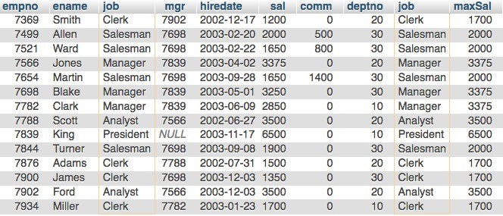
Option 2: Subqueries
practice_emp
empno | ename | job | sal
7369 | Smith | Clerk | 1200
7499 | Allen | Salesman | 2000
7521 | Ward | Salesman | 1650
7566 | Jones | Manager | 3375
7654 | Martin | Salesman | 1650
7698 | Blake | Manager | 3250
7782 | Clark | Manager | 2850
7788 | Scott | Analyst | 3500
7839 | King | President | 6500
7844 | Turner | Salesman | 1900
7876 | Adams | Clerk | 1500
7900 | James | Clerk | 1350
7902 | Ford | Analyst | 3500
7934 | Miller | Clerk | 1700
SELECT * FROM
practice_emp |  | E1,
 | (SELECT E2.job, MAX(E2.sal) AS maxSal FROM practice_emp E2 GROUP BY E2.job) T1
SELECT *
FROM 1 , 2
WHERE 1 .job = 2 .job;
WHERE E1.job = T1.job
1
JOIN
(on matching attributes)
2
job | maxSal
Analyst | 3500
Clerk | 1700
Manager | 3375
President | 6500
Salesman | 2000

Slide 45
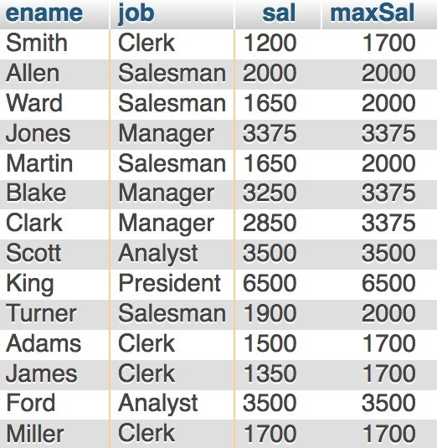
Option 2: Subqueries
practice_emp
empno | ename | job | sal
7369 | Smith | Clerk | 1200
7499 | Allen | Salesman | 2000
7521 | Ward | Salesman | 1650
7566 | Jones | Manager | 3375
7654 | Martin | Salesman | 1650
7698 | Blake | Manager | 3250
7782 | Clark | Manager | 2850
7788 | Scott | Analyst | 3500
7839 | King | President | 6500
7844 | Turner | Salesman | 1900
7876 | Adams | Clerk | 1500
7900 | James | Clerk | 1350
7902 | Ford | Analyst | 3500
7934 | Miller | Clerk | 1700
SELECT E1.ename, E1.job, E1.sal, T1.maxSal FROM practice_emp E1,
(SELECT E2.job, MAX(E2.sal) AS maxSal
FROM practice_emp E2 GROUP BY E2.job) T1
WHERE E1.job = T1.job
3
1
JOIN
(on matching attributes)
2
job | maxSal
Analyst | 3500
Clerk | 1700
Manager | 3375
President | 6500
Salesman | 2000

Slide 46
Option 3: WITH Clause
Find the employee name (or employees) with the highest salary for each job title
practice_emp
empno | ename | job | sal
7369 | Smith | Clerk | 1200
7499 | Allen | Salesman | 2000
7521 | Ward | Salesman | 1650
7566 | Jones | Manager | 3375
7654 | Martin | Salesman | 1650
7698 | Blake | Manager | 3250
7782 | Clark | Manager | 2850
7788 | Scott | Analyst | 3500
7839 | King | President | 6500
7844 | Turner | Salesman | 1900
7876 | Adams | Clerk | 1500
7900 | James | Clerk | 1350
7902 | Ford | Analyst | 3500
7934 | Miller | Clerk | 1700
Find max salary for each job
Then find the employee(s) with that max salary

Slide 47
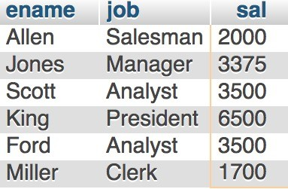
Option 3: WITH Clause
practice_emp
empno | ename | job | sal
7369 | Smith | Clerk | 1200
7499 | Allen | Salesman | 2000
7521 | Ward | Salesman | 1650
7566 | Jones | Manager | 3375
7654 | Martin | Salesman | 1650
7698 | Blake | Manager | 3250
7782 | Clark | Manager | 2850
7788 | Scott | Analyst | 3500
7839 | King | President | 6500
7844 | Turner | Salesman | 1900
7876 | Adams | Clerk | 1500
7900 | James | Clerk | 1350
7902 | Ford | Analyst | 3500
7934 | Miller | Clerk | 1700
Abstract immediate result using WITH clause
WITH MaxSal AS
(SELECT job, MAX(sal) AS salary FROM practice_emp
GROUP BY job)
SELECT FROM WHERE
E1.ename, E1.job, E1.sal practice_emp AS E1, MaxSal AS A E1.job = A.job
AND E1.sal = A.salary
1
JOIN
(on matching attributes)
2
job | maxSal
Analyst | 3500
Clerk | 1700
Manager | 3375
President | 6500
Salesman | 2000

